Slide 1




NumPy Arrays
Efficient numerical computing for machine learning
Notes:
NumPy allows for more efficient numerical computation on 'arrays'

Slide 2







What is NumPy?
NumPy (Numerical Python) is a powerful library for numerical computations in Python.
It is essential for most machine learning workflows.
Allows for fast operations on arrays (aka matrices)
Provides support for mathematical, logical, and statistical functions
Foundation for scientific computing libraries

Slide 3
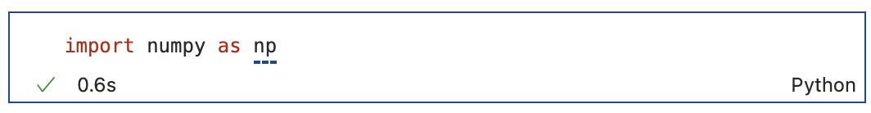
Importing NumPy
In every Jupyter Notebook or Python script where you use NumPy, you will need to install it as follows:

Slide 4

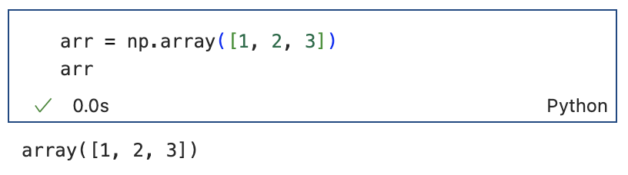
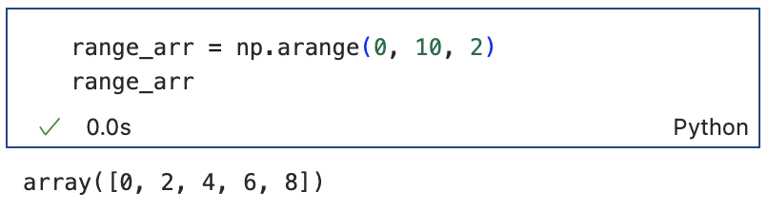
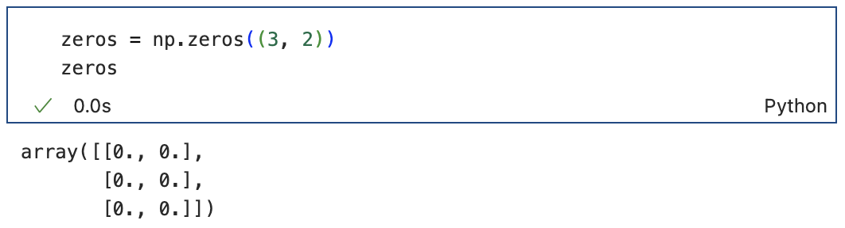
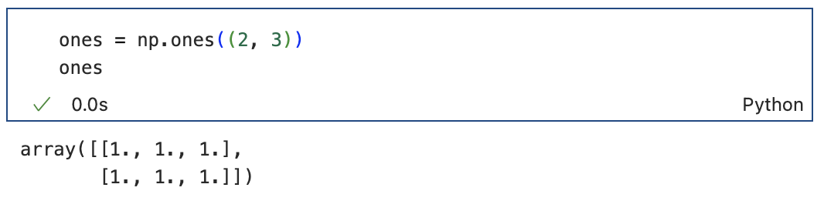
Basics of NumPy Arrays
NumPy arrays are homogeneous (single data-type), multi-dimensional arrays of numerical data.
You can create a NumPy array in several ways:
From a list:
From a range:
start
stop
step
start: starting value of the sequence (inclusive)
stop: ending value of the sequence (exclusive)
step: step size/interval between numbers in the sequence
Array of zeros:
Array of ones:
Outermost dimension
Innermost dimension
Outermost dimension
Innermost dimension
shape
shape

Slide 5
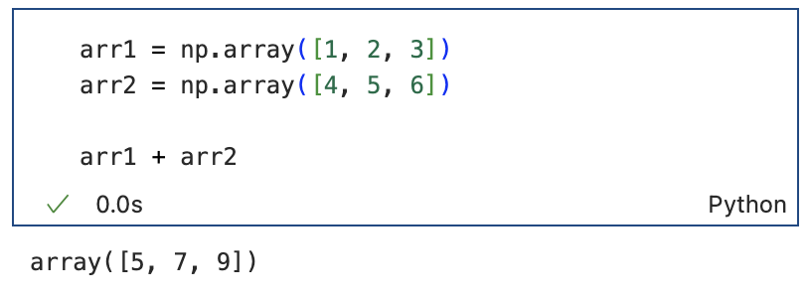
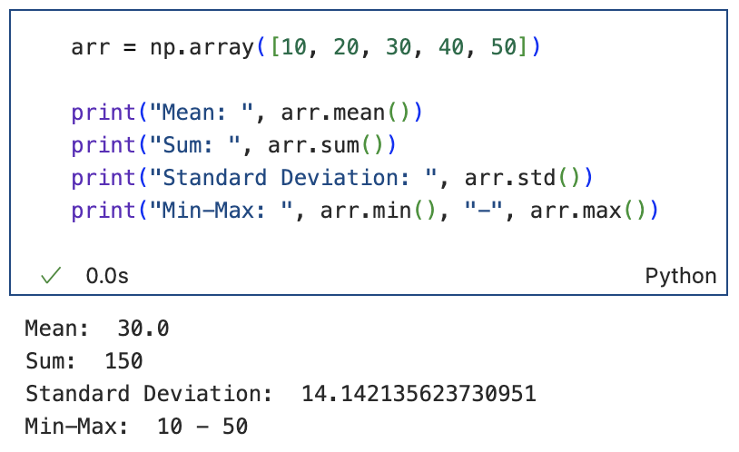
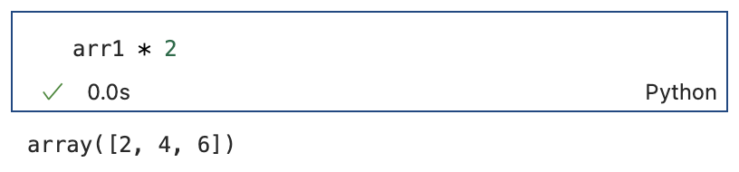
Key NumPy Functions & Methods
Element-wise Operations:
Aggregation & Description:

Slide 6
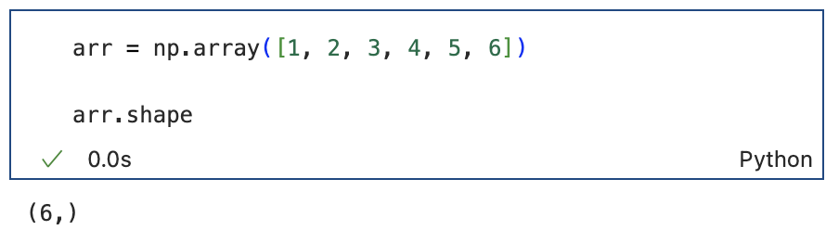
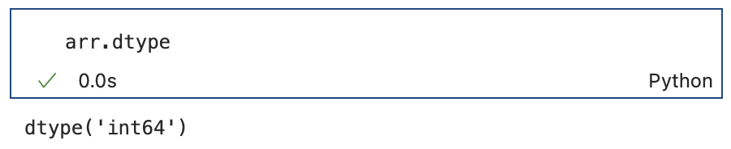
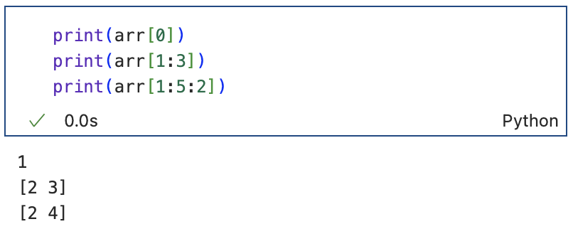
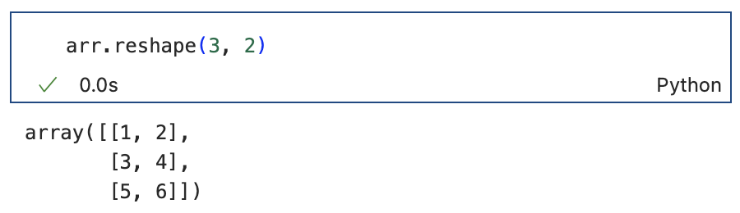
Key NumPy Functions & Methods
Determine an array's shape:
Determine the elements' data type:
They're integers!
Index & slice an array:
Reshape an array:
Outermost dimension
Innermost dimension
Slicing in NumPy uses the same start:stop:step format we saw earlier

Slide 7
You are given a list of blood glucose readings from participants in your study:
[85, 90, 120, 150]
The data is currently in mg/dL, but you need to convert them to mmol/L. The formula for conversion is:
mmol/L = mg/dL ÷ 18
Create a numpy array with the blood glucose values
Convert the values from mg/dL to mmol/L
Calculate the mean and standard deviation of the sample.
Challenge Yourself

Slide 8
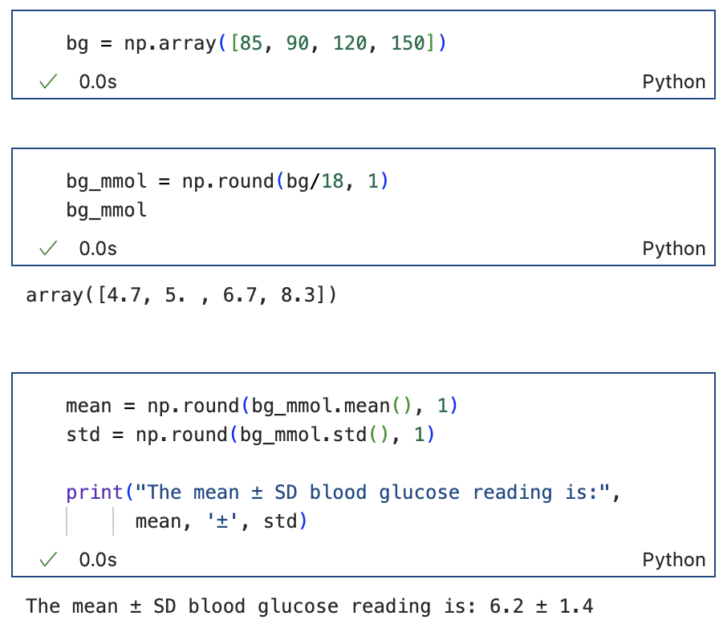

Specifies number of decimal places to round to
TIP: If you want to round your output value to a specified number of decimal points you can use the np.round() function like we did here.

